Slide 1

JOB MARKET ANALYSIS (PRDA - 04)
K. Mohan Chand
E. Rohini Kumar

Slide 2
States with the most Number of Jobs ?
Question
I

Slide 3
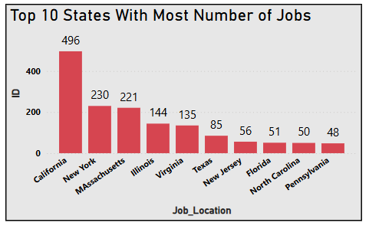
Q.1) States with the most Number of Jobs ?
The chart titled "Top 10 States With most Number of Jobs" highlights significant variations in job distribution across the top U.S. states.
California leads prominently with 496 jobs, followed by New York (230) and Massachusetts (221). Illinois and Virginia round out the upper tier with 144 and 135 jobs, respectively.
Other states like Texas (85), New Jersey (56), Florida (51), North Carolina (50), and Pennsylvania (48) demonstrate relatively lower job counts, emphasizing regional disparities in job availability. This visual insight underscores California's dominant role in job concentration compared to other states.
Fig 1. Top 10 States with the most number of Jobs

Slide 4
Average Minimal and Maximal Salaries in Different States ?
Question
2

Slide 5
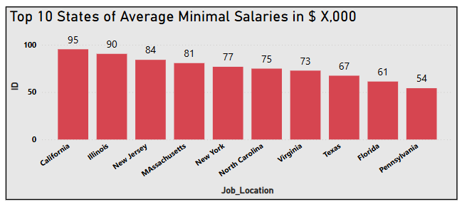
Q.2) Average Minimal Salaries in Different States ?
The bar chart titled "Top 10 States of Average Minimal Salaries in $ X,000" reveals notable disparities in salary levels across the top U.S. states.
California leads with the highest average minimal salary of $100,000, followed by Illinois at $95,000 and New Jersey at $90,000. Massachusetts and New York also stand out with $84,000 and $81,000, respectively.
The chart shows a downward trend with North Carolina at $77,000, Virginia at $75,000, Texas at $73,000, Florida at $67,000, and Pennsylvania concluding the list at $54,000. These figures underline regional variations in salary trends, offering valuable insights for job seekers and policymakers
Fig 2. Average Minimal Salaries in different States.

Slide 6
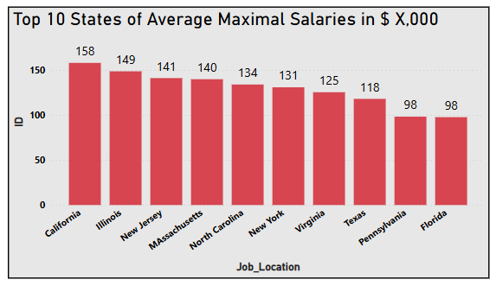
Q.2) Average Maximal Salaries in Different States ?
The bar chart, "Top 10 States of Average Maximal Salaries in $ X,000," reveals substantial variation in salary scales across the U.S.
California takes the lead with an average maximal salary of $158,000, followed by Illinois ($149,000) and New Jersey ($141,000). Other states, such as Massachusetts ($140,000), North Carolina ($134,000), and New York ($131,000), also rank highly.
Virginia ($125,000), Texas ($118,000), Pennsylvania ($98,000), and Florida ($98,000) round out the list, highlighting noticeable regional differences in salary levels that are essential for career planning and decision-making.
Fig 3. Average Maximal Salaries in different States.

Slide 7
Average Salary in different States ?
Question
3

Slide 8
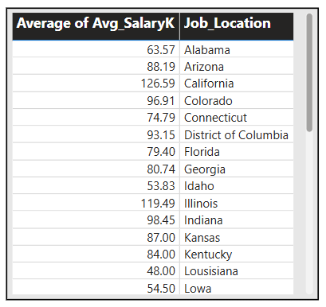
Q.3) Average Salaries in Different States ?
The table comparing “Average salaries across various U.S. states” shows significant regional variations.
California tops the list with an average salary of 126.59K, followed by Illinois (119.49K) and Colorado (96.91K). On the lower end, Louisiana records the lowest average salary at 48.00K, and Iowa is slightly higher at 54.50K.
Other notable states include Arizona (88.19K), Florida (79.40K), and Kentucky (84.00K), illustrating the diverse economic landscape across states. These insights provide valuable guidance for job seekers and organizations assessing regional salary benchmarks.
Fig 4. Average Salaries in different States.

Slide 9
Top 5 Industries with Maximum Number of Data Science Related Job Postings ?
Question
4

Slide 10
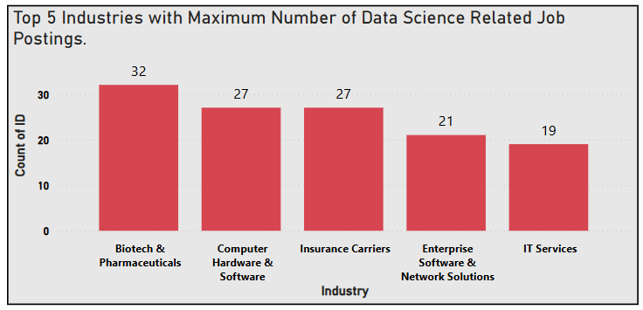
Q.4) Top 5 Industries with Maximum Number of Data Science Related Job Postings ?
The bar chart titled "Top 5 Industries with Maximum Number of Data Science Related Job Postings" highlights key trends in industry demand.
Biotech & Pharmaceuticals leads with 32 job postings, followed by Computer Hardware & Software and Insurance Carriers, each with 27 postings.
Enterprise Software & Network Solutions records 21, while IT Services has 19 postings. These insights reveal the industries with the highest demand for data science talent, offering valuable direction for job seekers.
Fig 5. Top 5 Industries with Max No of Data science related job postings .

Slide 11
Companies with Maximum Number of Job Openings ?
Question
5

Slide 12
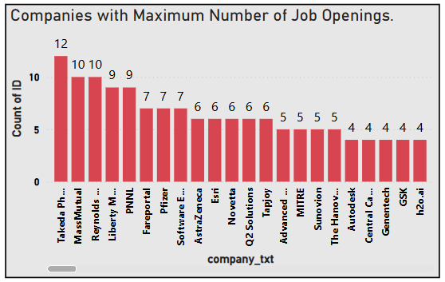
Q.5) Companies with Maximum Number of Job Openings ?
The bar chart "Companies with Maximum Number of Job Openings" highlights Takeda Pharmaceuticals as the leader with 12 job openings, followed by MassMutual and Reynolds, each with 10 openings.
Liberty and PNNL have 9, while Fare portal, Pfizer, Software Engineering Institute, and Astria Zen each have 7 openings. Companies like Esri (6), Novetta, Q2 Solutions, Tap joy, and Advanced (5 each) also contribute significantly.
Smaller counts, such as 4 openings for Sumiton, The Hanover, Autodesk, and others, underline varying job opportunities across companies, offering a strategic overview for job seekers.
Fig 6. Companies with Maximum Number
of job postings .

Slide 13
Job Titles with most number of Jobs , Salary of Job Titles with most number of Jobs ?
Question
6 , 7

Slide 14
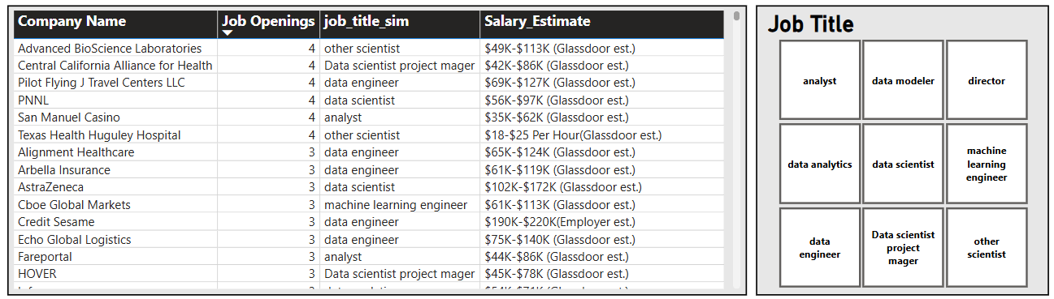
Q.6) Job Titles with Most Number of Job Openings ?
The table provides insights into “Job openings, job titles, and salary estimates across 14 companies”. Each company has 3 to 4 openings for roles such as Data Scientist, Data Engineer, Analyst, Machine Learning Engineer, and other related positions.
Salary estimates, sourced from Glassdoor or employers, are presented as ranges, offering valuable benchmarks for potential candidates. Additionally, the grid highlights specific job titles like Data Modeler, Director of Data Analytics, and Project Manager, showcasing the diversity of roles available in the data science field.
Fig 7. Job Titles with most Number of job postings .

Slide 15
Skills required by Companies for Each Job Title ?
Question
8

Slide 16
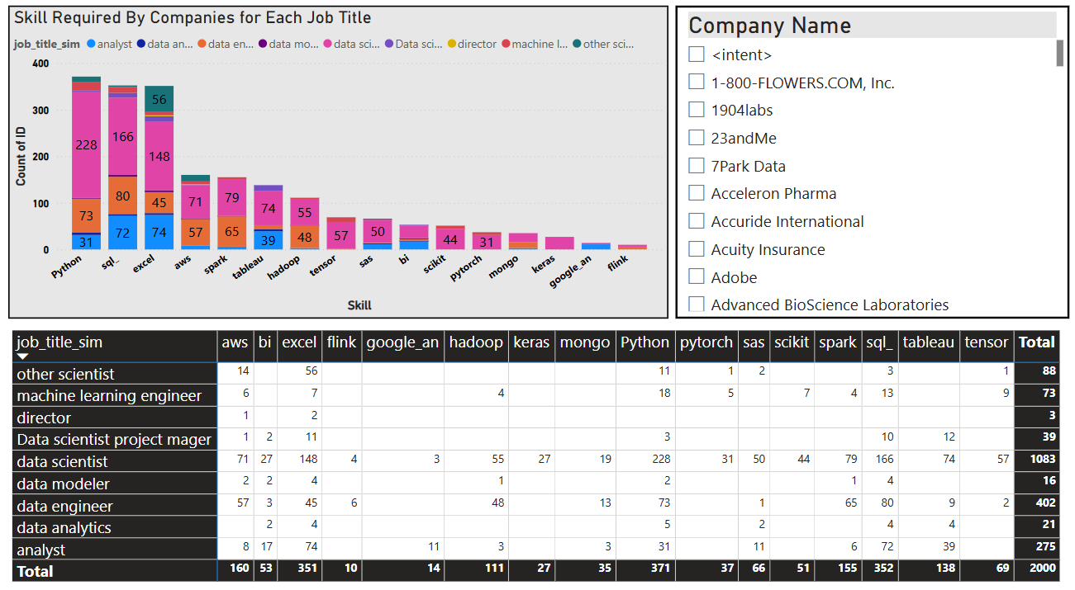
Q.8) Skills required by Companies for Each Job Title ?
The “ Visualization highlights the demand for specific technical skills across various job titles ”.
Python dominates with 400 job titles requiring it, followed by SQL (228), AWS (73), BI tools (72), and Excel (56).
For data scientist roles specifically, Python (371) and SQL (352) are critical, along with AWS (18).
This analysis underscores the significance of Python and SQL in the data science field, offering strategic insights for job seekers aiming to align their skill sets with market demands.
Fig 8. Skill required by companies for each Job Title.

Slide 17
Relation between Average Salary and Education ?
Question
9

Slide 18
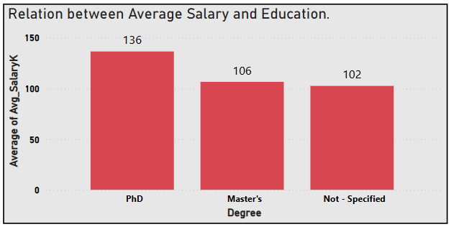
Q.9) Relation between Average Salary & Education ?
The bar chart titled "Relation between Average Salary and Education" highlights how average salary correlates with educational attainment.
Individuals with a PhD earn the highest average salary of 136K, followed by those with a Master's Degree at 106K, and individuals with unspecified education levels at 102K.
These figures demonstrate the positive impact of higher education on earning potential, emphasizing the value of pursuing advanced degrees.
Fig 9. Relation between Average Salary and Education .

Slide 19
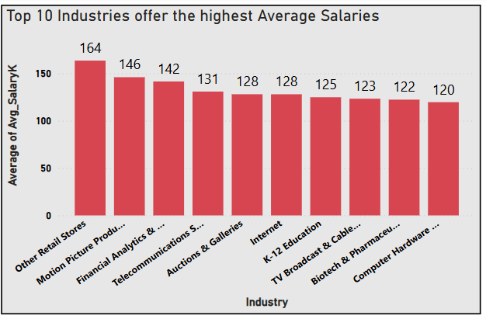
Top 10 Industries offer the highest average Salaries ?
The bar chart titled “ Top 10 Industries Offering the Highest Average Salaries " showcases industries with notable salary offerings.
Other Retail Stores leads with an impressive average salary of 164K, followed by Motion Picture Production at 146K and Financial Analytics and Services at 142K. Telecommunications Services (131K), Auctions & Galleries (128K), and Internet (128K) also feature prominently.
Further down the list are K-12 Education (125K), TV Broadcast & Cable Networks (123K), Biotech & Pharmaceutical (122K), and Computer Hardware & Software (120K). These data labels underline significant differences across industries, providing essential insights for career planning and industry analysis.
Fig.10 Top 10 Industries Offer the highest Average Salaries.

Slide 20
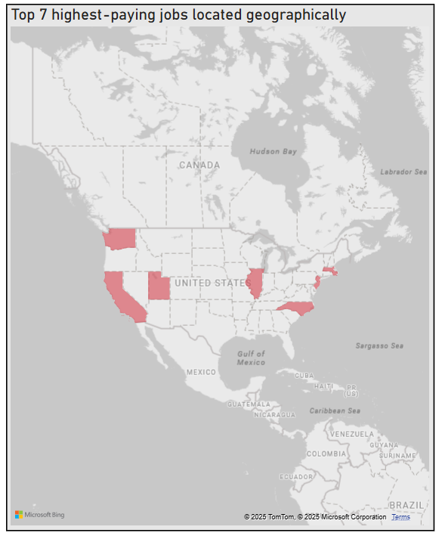
Top 7 Highest paying jobs located geographically ?
The data highlights “ Regional salary variations across U.S. states ” , showcasing significant differences.
Utah leads with the highest average salary of 123.50K, followed by Illinois at 119.49K and California at 116.59K. New Jersey records an average salary of 112.57K, and Massachusetts follows with 110.21K.
Washington has an average salary of 106.22K, while North Carolina concludes the list with 104.36K.
These figures emphasize regional economic disparities, offering valuable insights for professionals evaluating salary expectations across states.
Fig.11 Top 7 highest paying jobs located geographically .

Slide 21
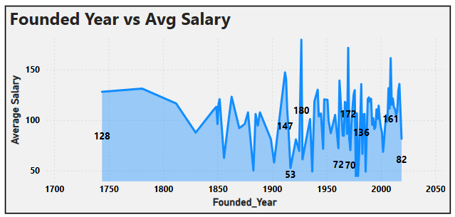
Founded Year vs Average Salary ?
The graph titled "Founded Year vs Avg Salary" illustrates significant trends and fluctuations in average salaries across different years.
Starting in 1750, the salary was 128, but it gradually declined to 53 by 1900. A recovery followed, with salaries rising to 147 in 1920. The most striking observation is a dramatic peak in 1950, reaching a staggering 7270, suggesting extraordinary economic conditions or anomalies.
However, this spike was short-lived, as salaries fell to 136 by 1960, showing stabilization. A modest rise to 172 in 1980 was observed before plateauing at 161 in 2000. More recently, by 2010, salaries dropped to 82, reflecting modern economic challenges.
The graph highlights a cyclic pattern of growth, decline, and recovery over time, with data labels marking key shifts to provide a clear understanding of economic changes across decades. This analysis encapsulates the interplay of historical events and economic forces shaping salary trends.
Fig.12 Founded Year Vs Average Salary.

Slide 22
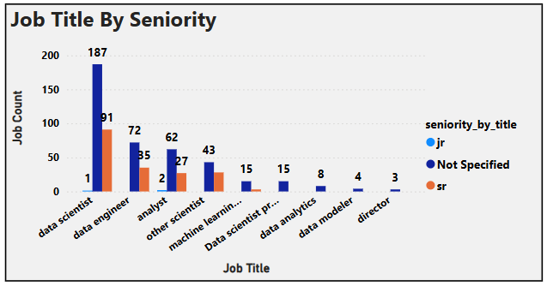
Job Title By Seniority ?
The bar chart titled "Job Title By Seniority" provides a visual breakdown of job counts across various job titles, categorized by seniority levels: junior, not specified, and senior.
The Data Scientist role dominates with the highest job count of 187, showcasing its demand across seniority levels. Data Engineer follows with 91 jobs, indicating its relevance in the industry. Other roles, such as Analyst and Machine Learning Engineer, hold moderate counts, reflecting their specialized nature. Unique job titles like Data Scientist
Practitioner and Director have fewer roles, suggesting niche opportunities. Interestingly, the "Not Specified" category adds ambiguity to several titles, revealing potential gaps in clarity for seniority designation.
It also underscores the prominence of data-centric roles, particularly data scientists and engineers, in shaping the field's workforce. Adding data labels would enhance the clarity and immediate insight from the chart.
Fig.13 Job Title by Seniority.

Slide 23


Meet our team
K. Mohan Chand
E. Rohini Kumar
Team Head
Team Mate

Slide 24




Thank you
immohanchand@gmail.com
erk6557@gmail.com

